Slide 1
New Jersey PPP Loan Analysis
Andrew Seamon
https://data.nj.gov/Government-Finance/PPP-Cares-Act-Loan-Totals-to-New-Jersey-Businesses/riep-z5cp

Slide 2
What is a PPP Loan? And why you should care.
Updated: July 17, 2020
Data Provided by: Small Business Administration
The Paycheck Protection Program (PPP) loans provide small businesses with the resources they need to continue payroll, hire back employees who were laid off, and cover overhead. This data set includes businesses in New Jersey who received PPP funding, how much funding the employer received, and how many jobs the employer claims they saved.
Many people who I spoke with knew little to nothing about PPP loans. My hope is that this presentation and subsequent Notebook will be your baseline of knowledge about the distribution of PPP loans in New Jersey.
This dataset was used to analyze the distribution of Payment Protection Program loans within New Jersey. In this notebook is a breakdown consisting of loan bracket, business owner race, and other important distinctions within PPP loan distribution.

Slide 3
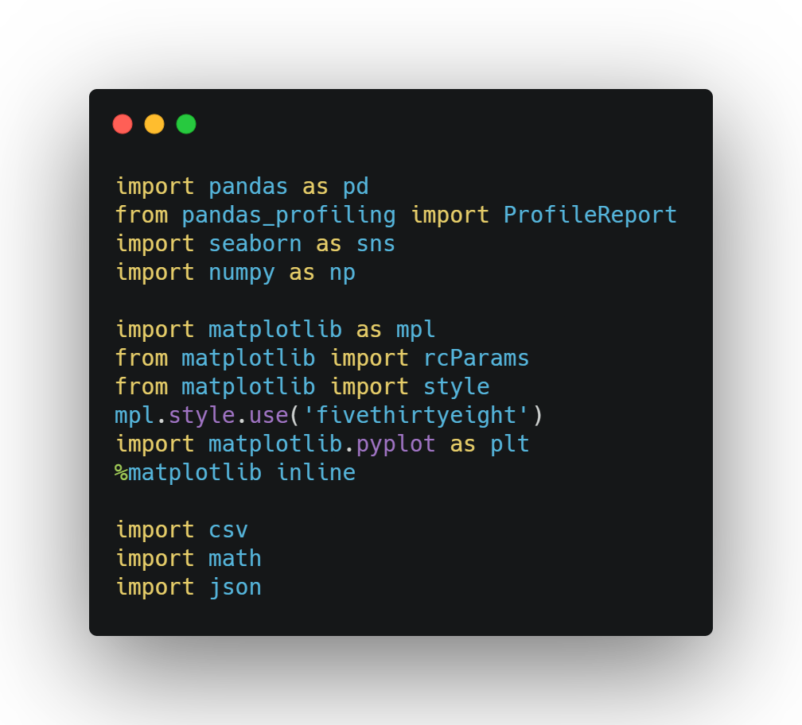
Necessary Imports and Other Standardizations

Slide 4
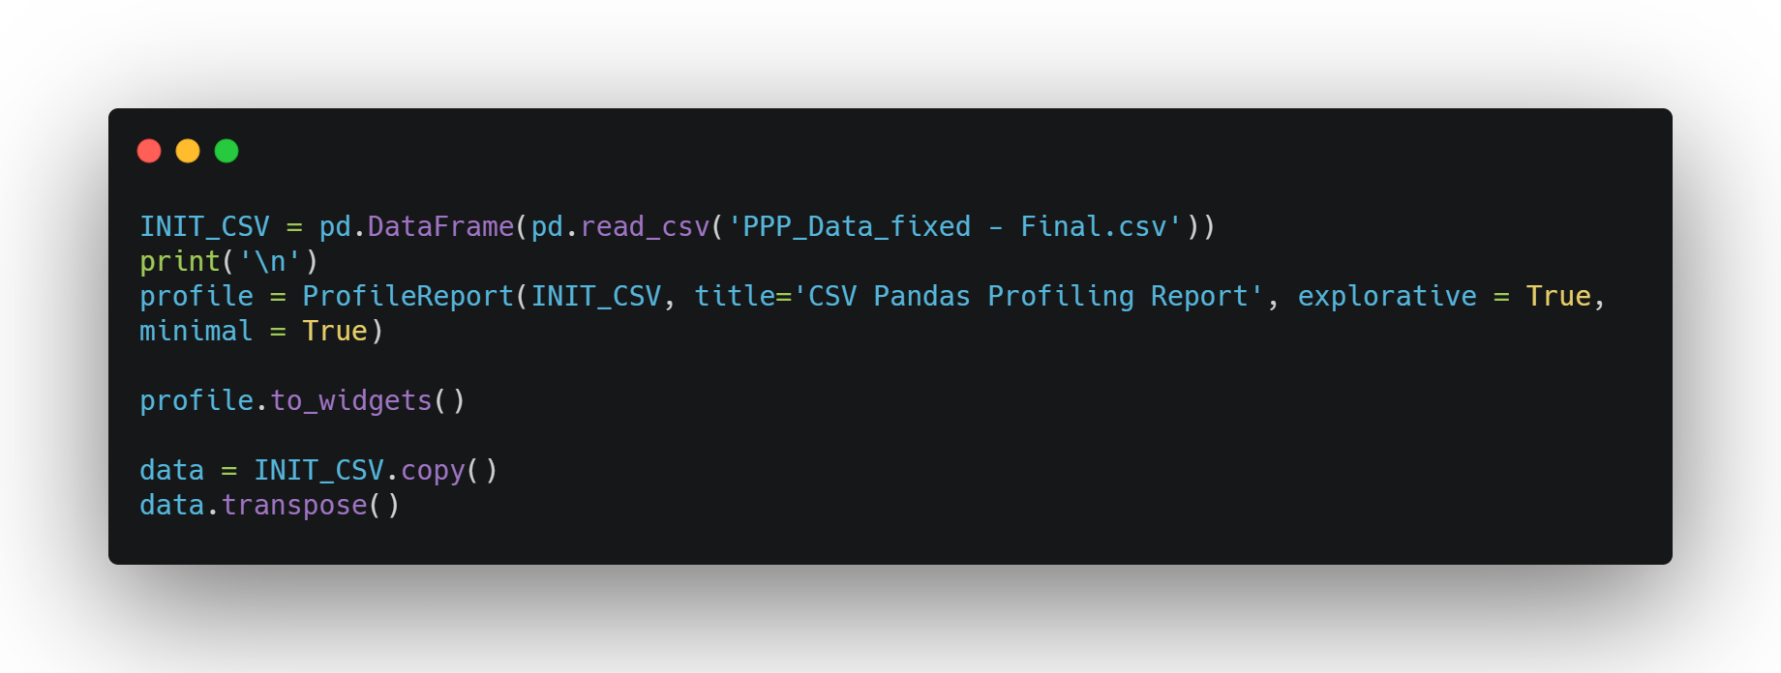
To gain a sense of direction and validity, I first created a profile through Pandas. I also transposed some data to see what I was working with.

Slide 5
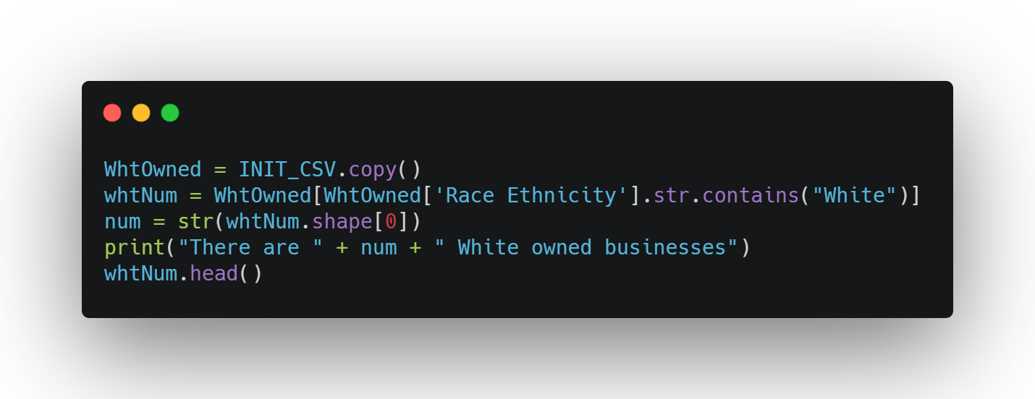
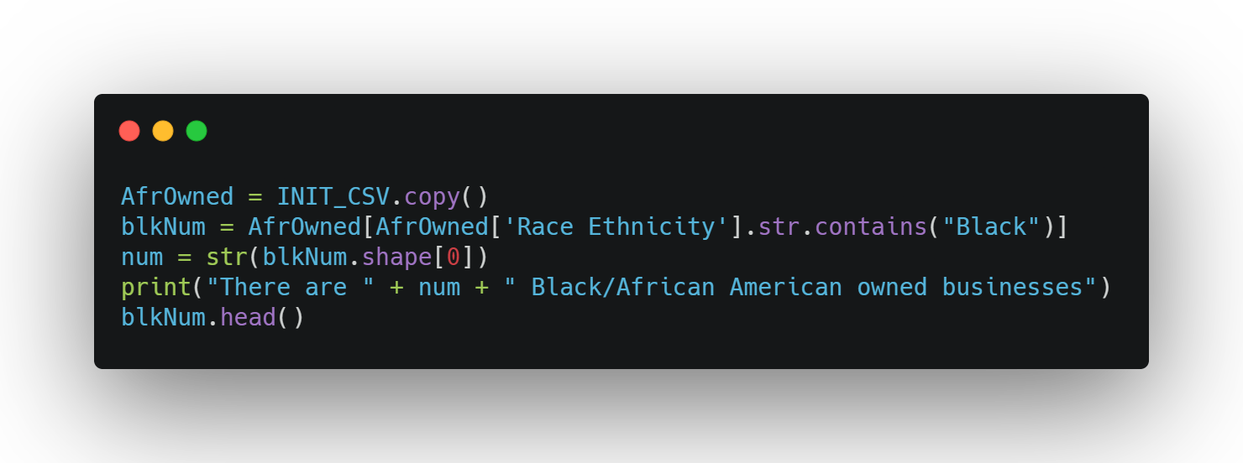
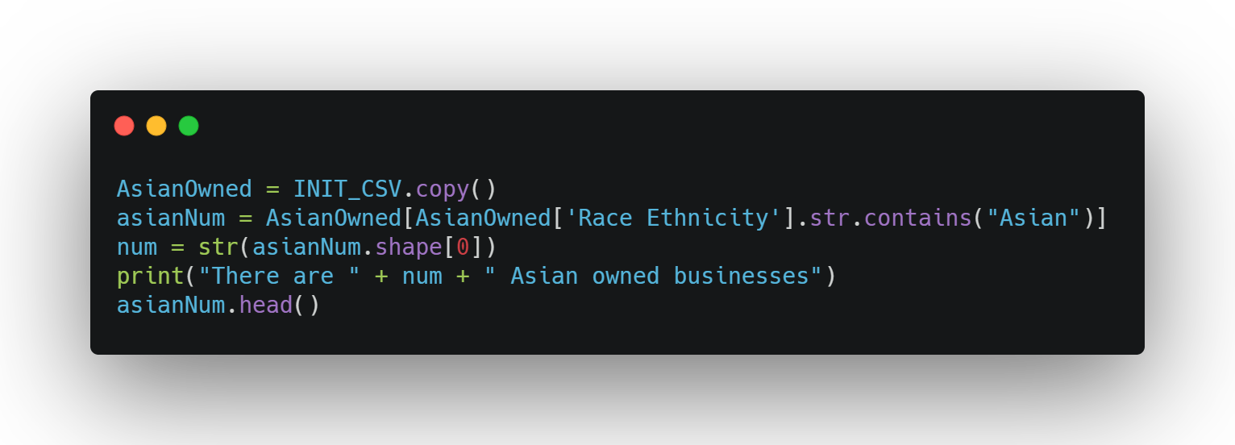
To gain a better understanding of the state and distribution of loans, I queried for the number of loans given to each of the three major ethnicities within the state.

Slide 6
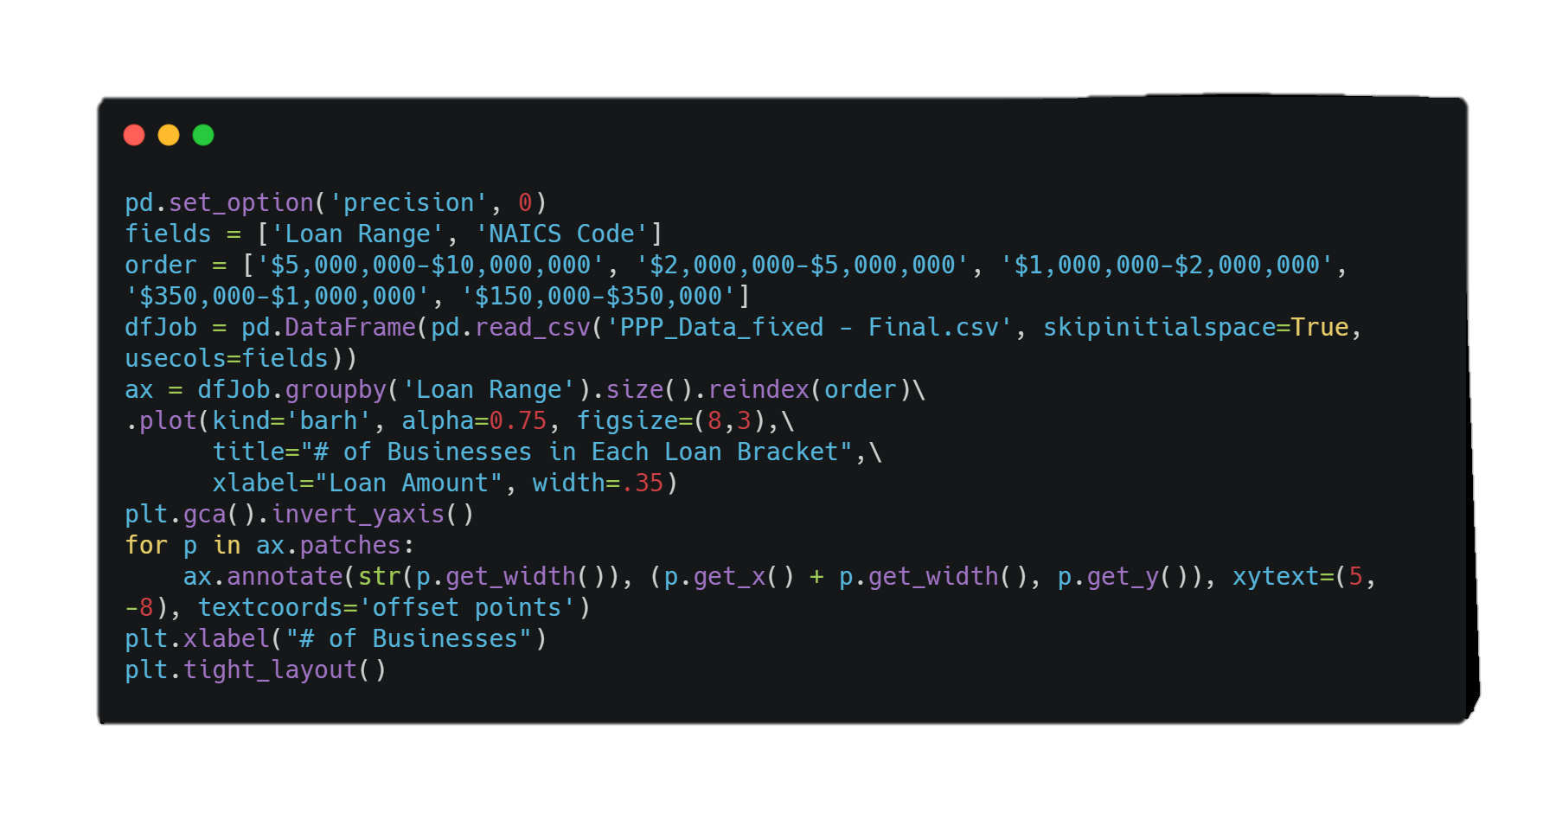
In the pursuit of information, one might be curious how many businesses applied for loans within each bracket. The code shown here will graph just that.
Brackets:
$150k - $350k
$350k - $1mil
$1mil - $2mil
$2mil - $5mil
$5mil - $10mil

Slide 7
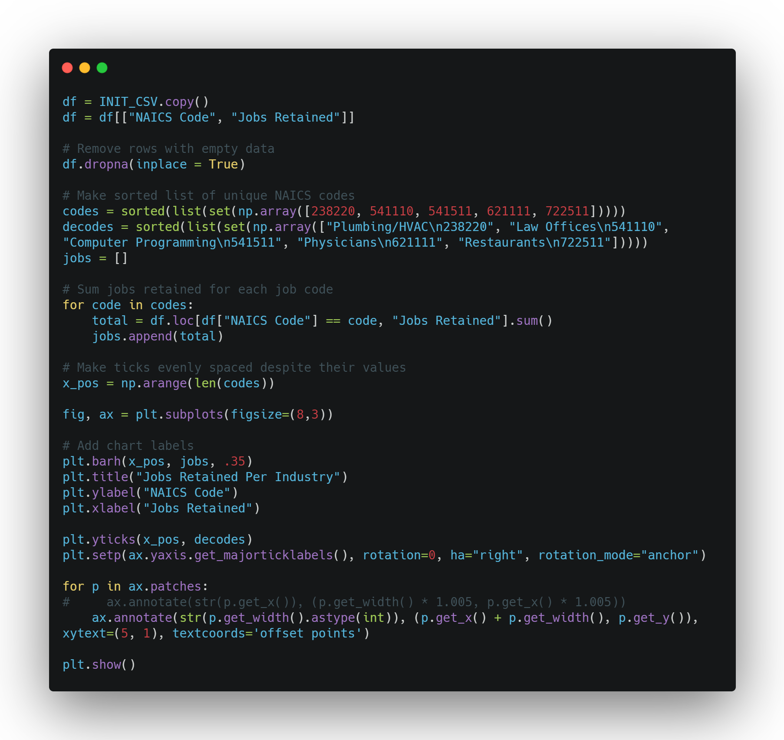
In the pursuit of information, one might be curious which industries saved the most jobs. The code shown here will graph the Top 5 along with their NAICS code and description.

Slide 8
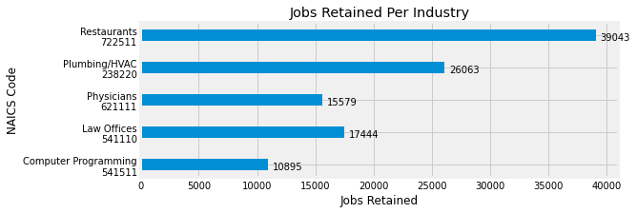
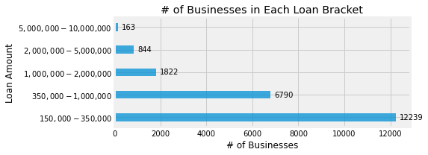

Slide 9
